Slide 1
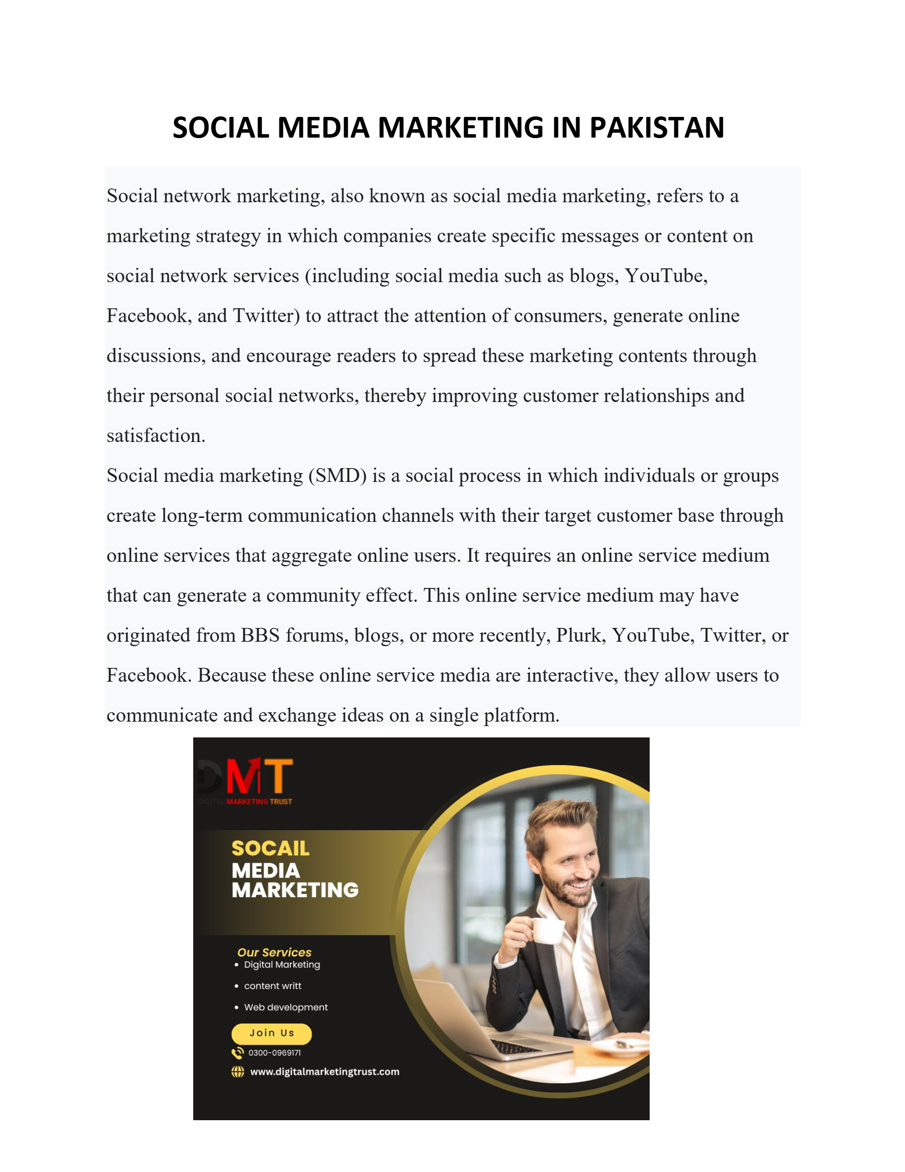
Slide 1
Notes:
SOCIAL MEDIA MARKETING IN PAKISTAN Social network marketing, also known as social media marketing, refers to a marketing strategy in which companies create specific messages or content on social network services (including social media such as blogs, YouTube, Facebook, and Twitter) to attra ct the attention of consumers, generate online discussions, and encourage readers to spread these marketing contents through their personal social networks, thereby improving customer relationships and satisfaction. Social media marketing (SMD) is a soci al process in which individuals or groups create long - term communication channels with their target customer base through online services that aggregate online users. It requires an online service medium that can generate a community effect. This online se rvice medium may have originated from BBS forums, blogs, or more recently, Plurk, YouTube, Twitter, or Facebook. Because these online service media are interactive, they allow users to communicate and exchange ideas on a single platform.

Slide 2
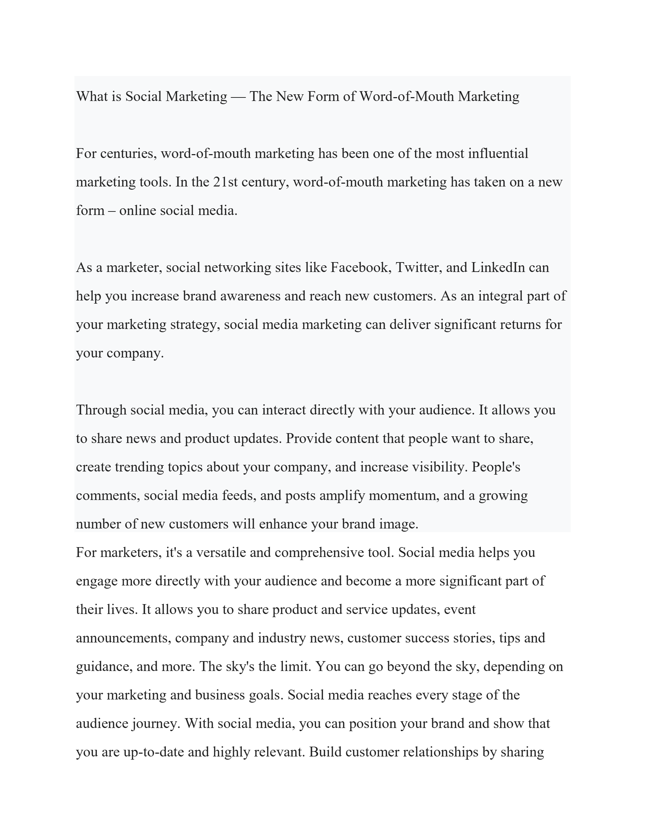
Slide 2
Notes:
What is Social Mar keting — The New Form of Word - of - Mouth Marketing For centuries, word - of - mouth marketing has been one of the most influential marketing tools. In the 21st century, word - of - mouth marketing has taken on a new form – online social media. As a marketer, socia l networking sites like Facebook, Twitter, and LinkedIn can help you increase brand awareness and reach new customers. As an integral part of your marketing strategy, social media marketing can deliver significant returns for your company. Through social media, you can interact directly with your audience. It allows you to share news and product updates. Provide content that people want to share, create trending topics about your company, and increase visibility. People's comments, social media feeds, and posts amplify momentum, and a growing number of new customers will enhance your brand image. For marketers, it's a versatile and comprehensive tool. Social media helps you engage more directly with your audience and become a more significant part of their lives. It allows you to share product and service updates, event announcements, company and industry news, customer success stories, tips and guidance, and more. The sky's the limit. You can go beyond the sky, depending on your marketing and business goals. Social media reaches every stage of the audience journey. With social media, you can position your brand and show that you are up-to-date and highly relevant. Build customer relationships by sharing

Slide 3
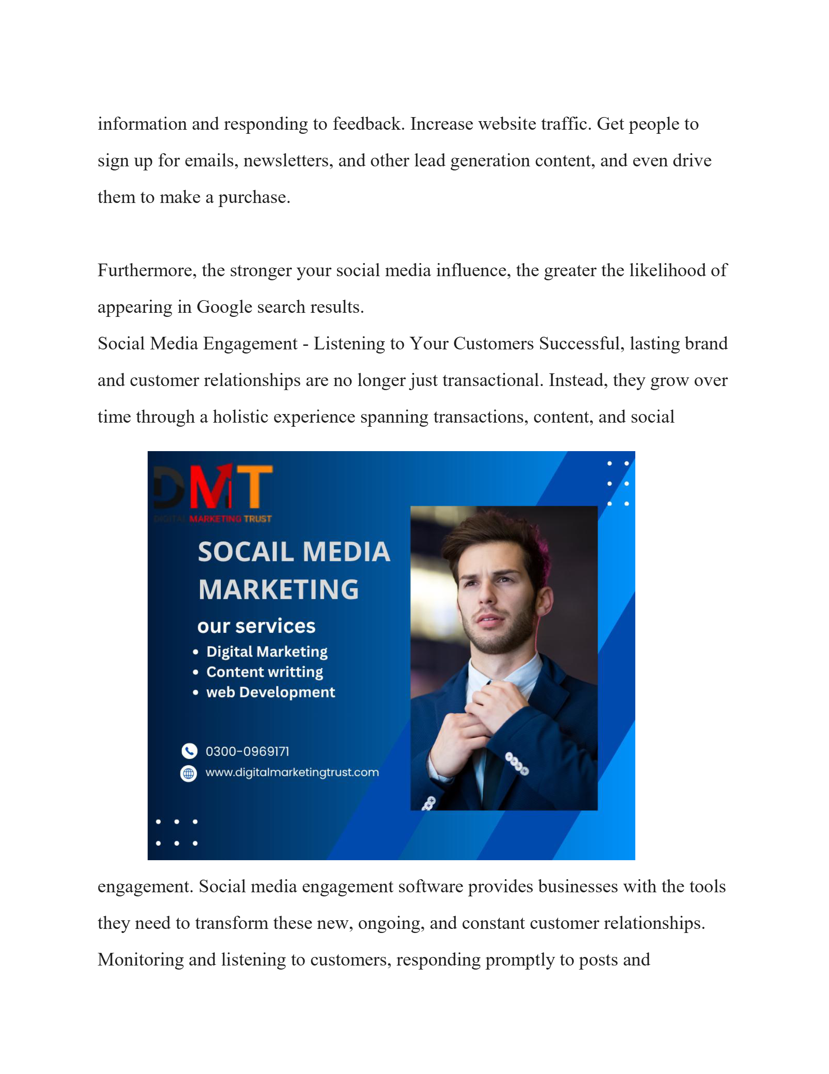
Slide 3
Notes:
information and responding to feedback. Increase website traffic. Get people to sign up for emails, newsletters, and other lead generation content, and even drive them to make a purchase. Furthermore, the stronger your social media influence, the greater the likelihood of appearing in Google search results. Social Media Engagement - Listening to Your Customers Successful, lasting brand and customer relationships are no longer just transactional. Instead, they grow over time through a holistic experience spanning transactions, content, and social engagement. Social media engagement software provides businesses with the tools they need to transform these new, ongoing, and constant customer relationships. Monitoring and listening to customers, responding promptly to posts and

Slide 4
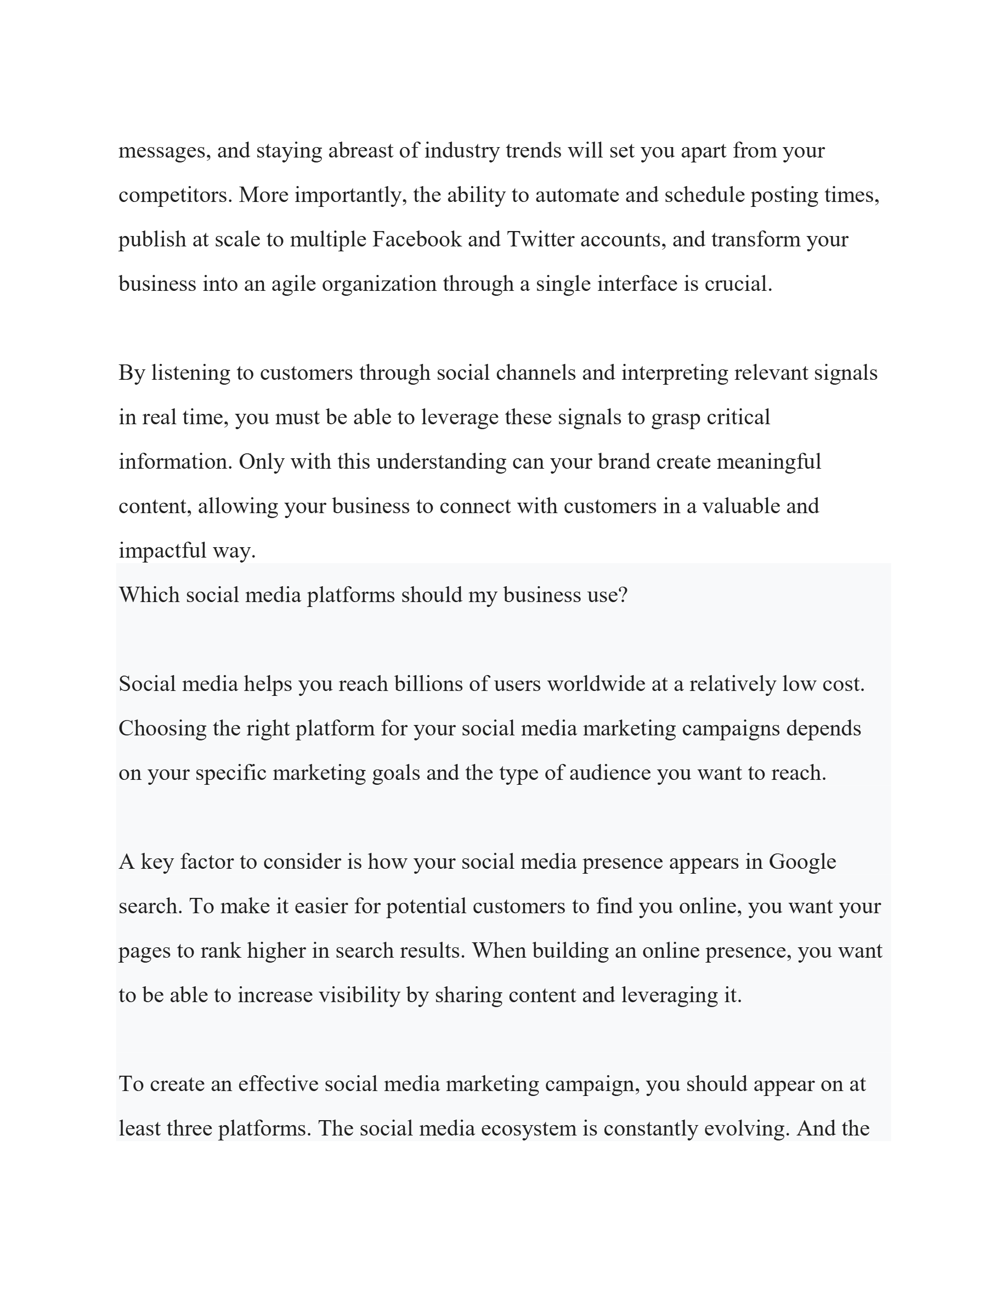
Slide 4
Notes:
messages, and staying abreast of industry trends will set you apart from your competitors. More importantly, the ability to automate and schedule posting times, publish at scale to multiple Facebook and Twitter accounts, and transform your business into an agile organization through a single interface is crucial. By listening to customers through social channels and interpreting relevant signals in real time, you must be able to leverage these signals to grasp critical information. Only with this understanding can your brand create meaningful content, allowing your business to connect with customers in a valuable and impactful way. Which social media platforms should my business use? Social media helps you reach billions of users worldwide at a relatively low cost. Choosing the right platform for your social media marketing campaigns depends on your specific marketing goals and the type of audience you want to reach. A key factor to consider is how your social media presence appears in Google search. To make it easier for potential customers to find you online, you want your pages to rank higher in search results. When building an online presence, you want to be able to increase visibility by sharing content and leveraging it. To create an effective social media marketing campaign, you should appear on at least three platforms. The social media ecosystem is constantly evolving. And the

Slide 5
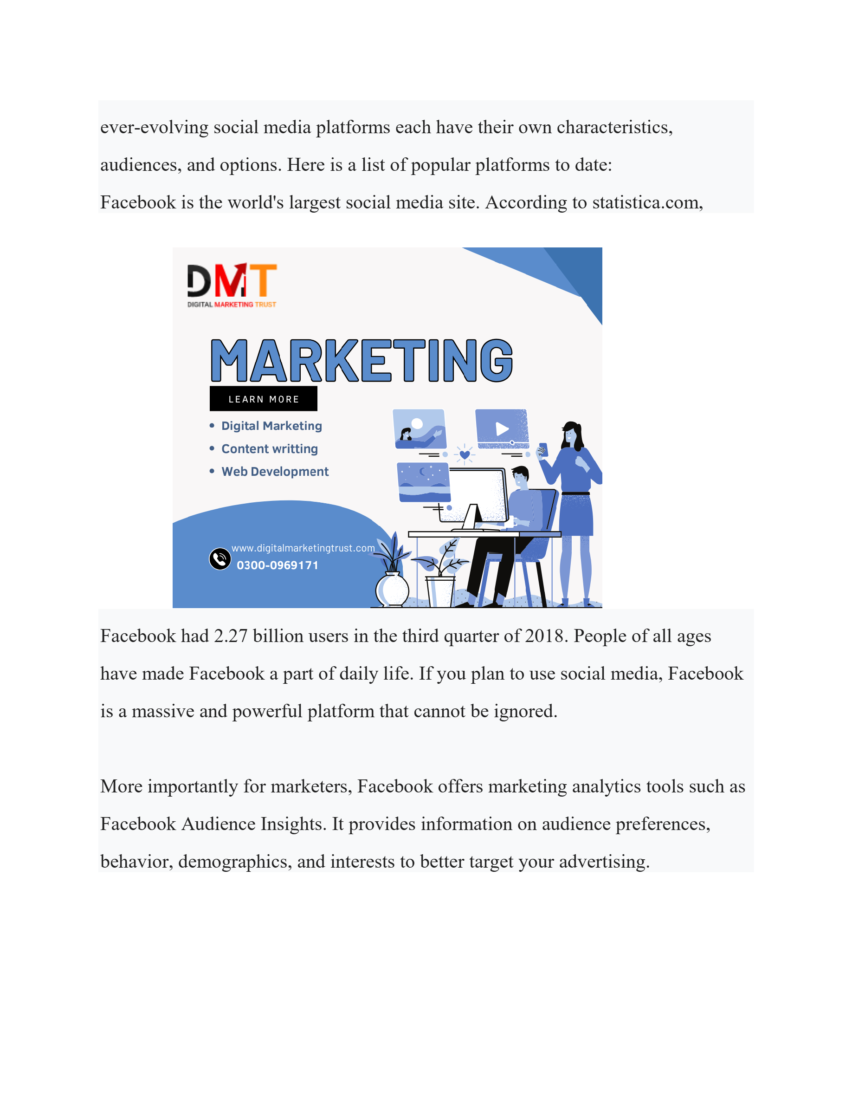
Slide 5
Notes:
ever - evolving social media platforms each have their own characteristics, audiences, and optio ns. Here is a list of popular platforms to date: Facebook is the world's largest social media site. According to statistica.com, Facebook had 2.27 billion users in the third quarter of 2018. People of all ages have made Facebook a part of daily life. If y ou plan to use social media, Facebook is a massive and powerful platform that cannot be ignored. More importantly for marketers, Facebook offers marketing analytics tools such as Facebook Audience Insights. It provides information on audience preferences, behavior, demographics, and interests to better target your advertising.

