Slide 1
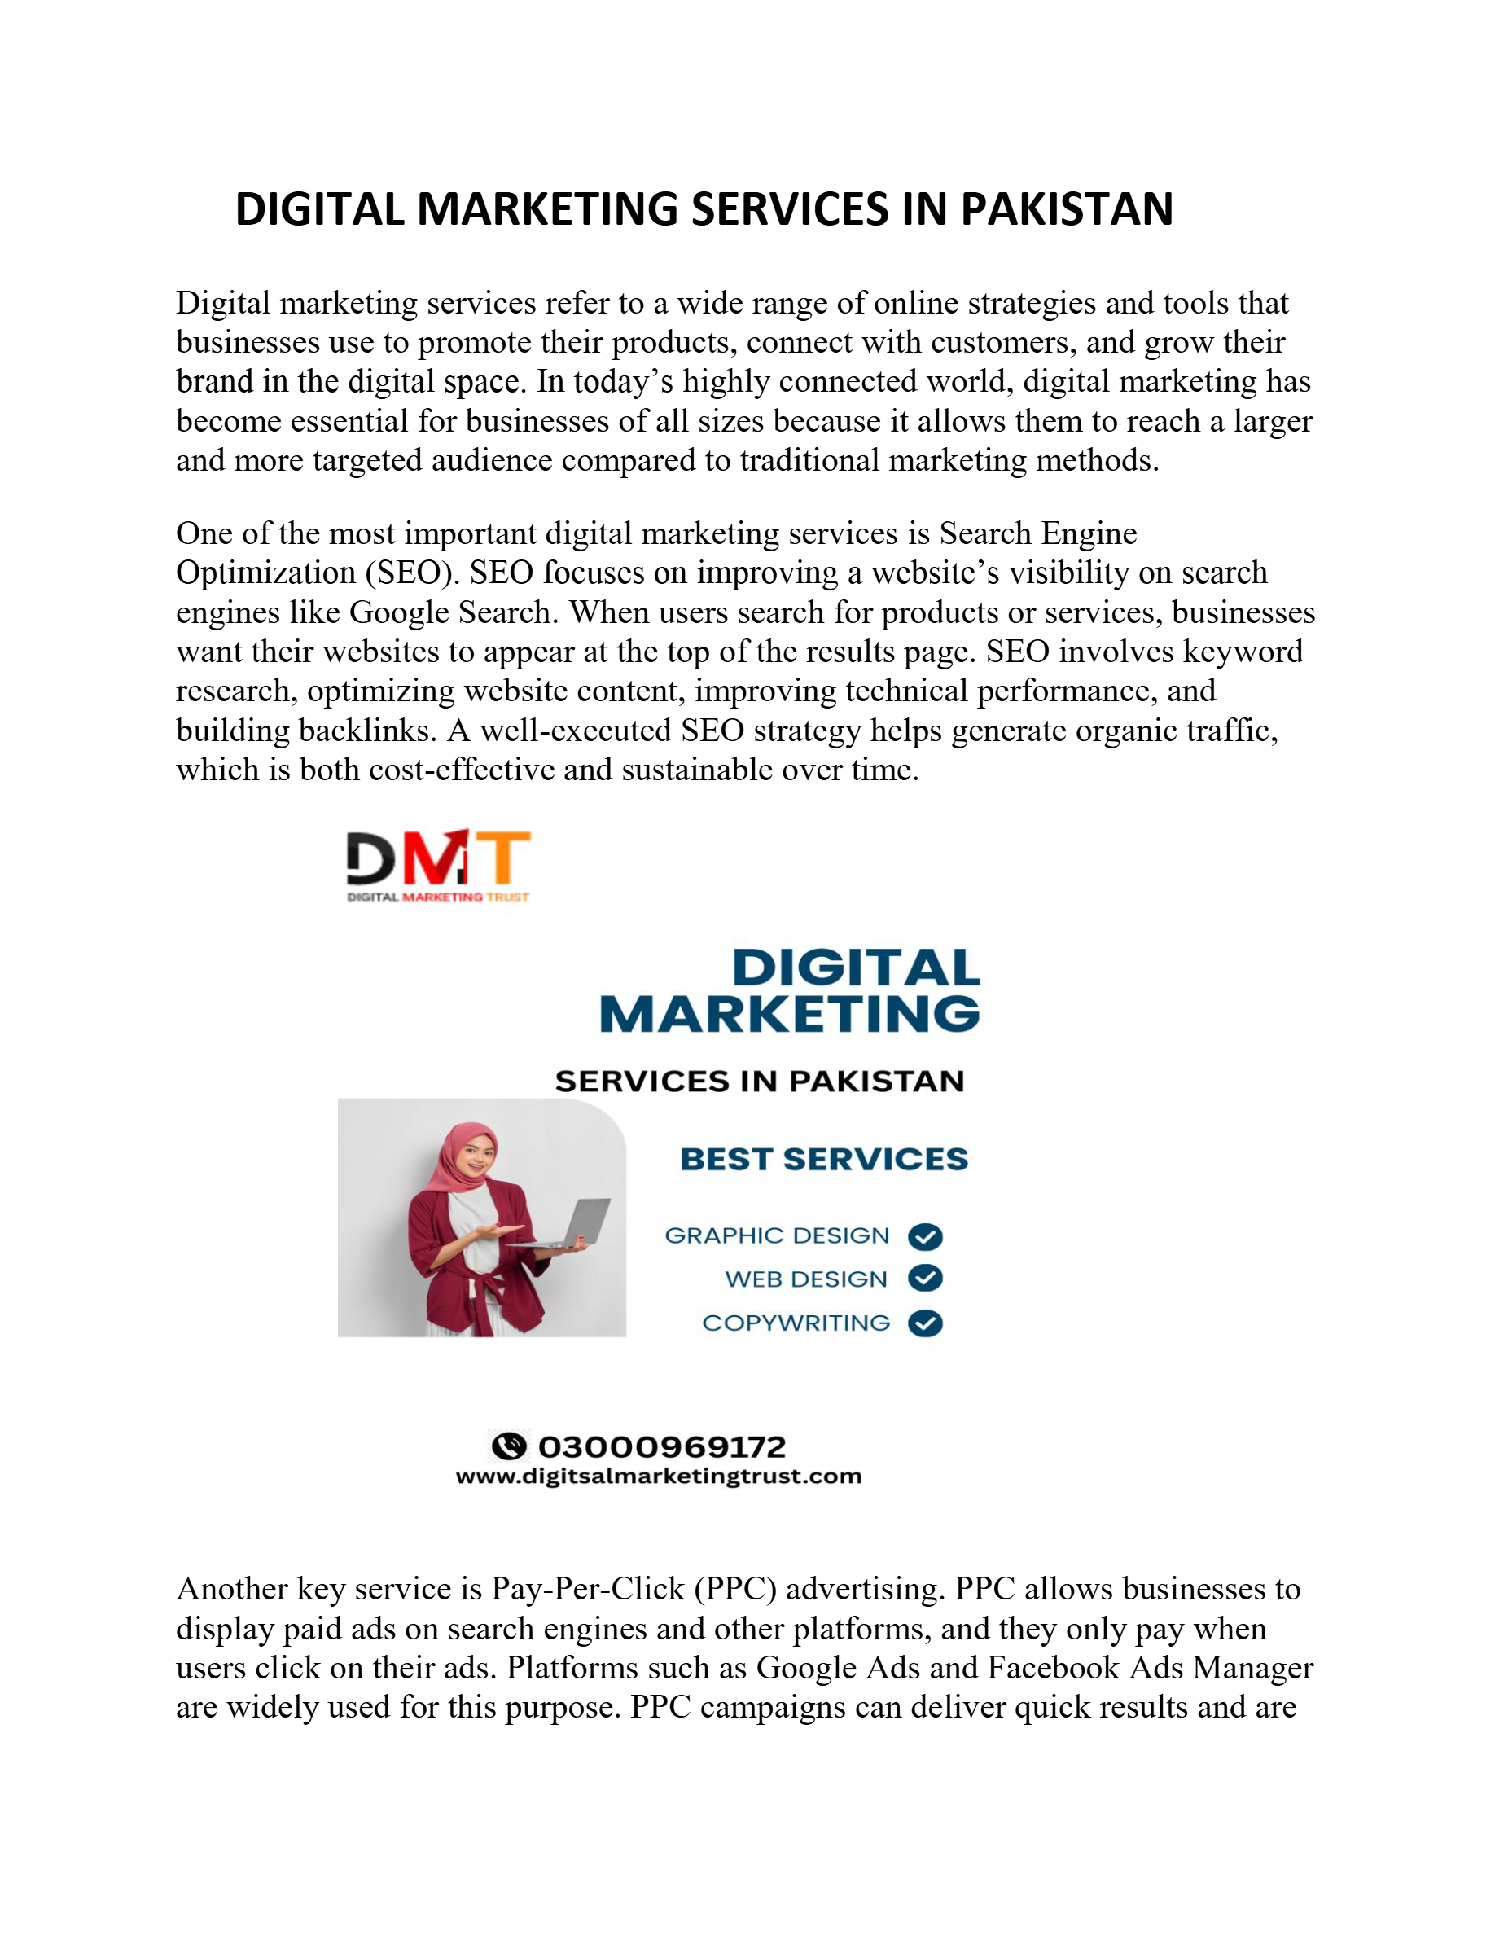
Slide 1
Notes:
DIGITAL MARKETING SERVICES IN PAKISTAN Digital marketing services refer to a wide range of online strategies and tools that businesses use to promote their products, connect with customers, and grow their brand in the digital space. In today’s highly connected world, digital marketing has become essential for businesses of all sizes because it allows them to reach a larger and more targeted audience compared to traditional marketing methods. One of the most important digital marketing services is Search Engine Optimization (SEO). SEO focuses on improving a website’s visibility on search engines like Google Search. When users search for products or services, businesses want their websites to appear at the top of the results page. SEO involves keyword research, optimizing website content, improving technical performance, and building backlinks. A well-executed SEO strategy helps generate organic traffic, which is both cost-effective and sustainable over time. Another key service is Pay-Per-Click (PPC) advertising. PPC allows businesses to display paid ads on search engines and other platforms, and they only pay when users click on their ads. Platforms such as Google Ads and Facebook Ads Manager are widely used for this purpose. PPC campaigns can deliver quick results and are

Slide 2
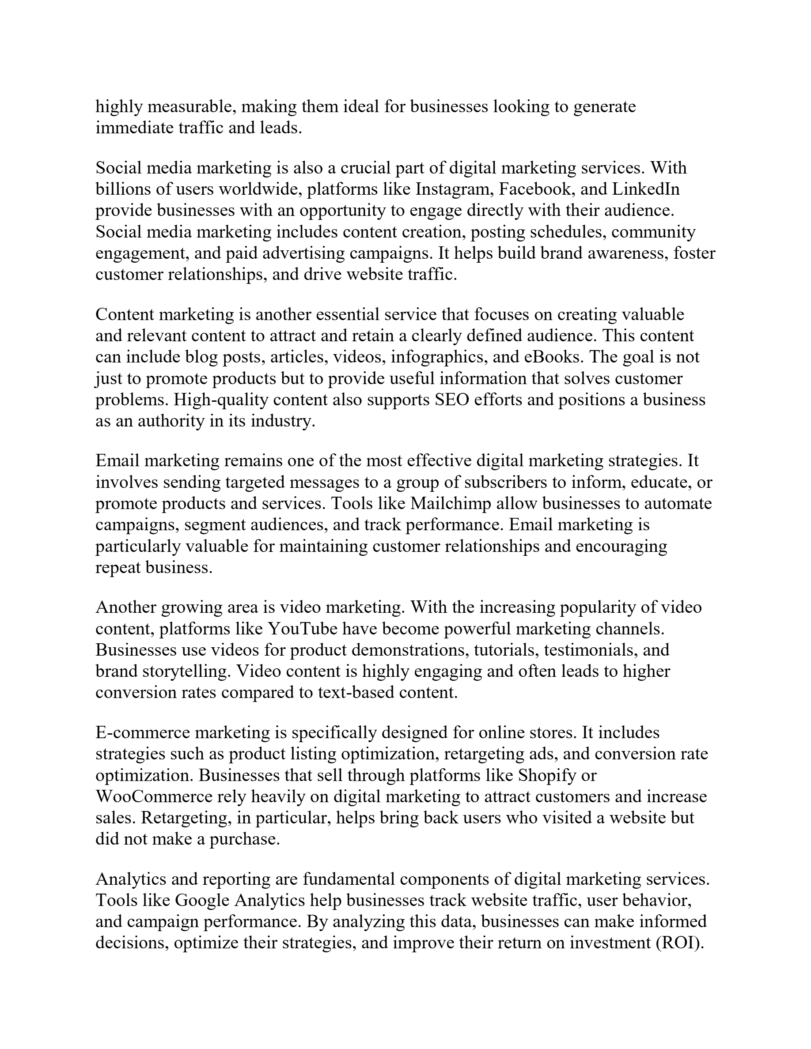
Slide 2
Notes:
highly measurable, making them ideal for businesses looking to generate immediate traffic and leads. Social media marketing is also a crucial part of digital marketing services. With billions of users worldwide, platforms like Instagram, Facebook, and LinkedIn provide businesses with an opportunity to engage directly with their audience. Social media marketing includes content creation, posting schedules, community engagement, and paid advertising campaigns. It helps build brand awareness, foster customer relationships, and drive website traffic. Content marketing is another essential service that focuses on creating valuable and relevant content to attract and retain a clearly defined audience. This content can include blog posts, articles, videos, infographics, and eBooks. The goal is not just to promote products but to provide useful information that solves customer problems. High-quality content also supports SEO efforts and positions a business as an authority in its industry. Email marketing remains one of the most effective digital marketing strategies. It involves sending targeted messages to a group of subscribers to inform, educate, or promote products and services. Tools like Mailchimp allow businesses to automate campaigns, segment audiences, and track performance. Email marketing is particularly valuable for maintaining customer relationships and encouraging repeat business. Another growing area is video marketing. With the increasing popularity of video content, platforms like YouTube have become powerful marketing channels. Businesses use videos for product demonstrations, tutorials, testimonials, and brand storytelling. Video content is highly engaging and often leads to higher conversion rates compared to text-based content. E-commerce marketing is specifically designed for online stores. It includes strategies such as product listing optimization, retargeting ads, and conversion rate optimization. Businesses that sell through platforms like Shopify or WooCommerce rely heavily on digital marketing to attract customers and increase sales. Retargeting, in particular, helps bring back users who visited a website but did not make a purchase. Analytics and reporting are fundamental components of digital marketing services. Tools like Google Analytics help businesses track website traffic, user behavior, and campaign performance. By analyzing this data, businesses can make informed decisions, optimize their strategies, and improve their return on investment (ROI).

Slide 3
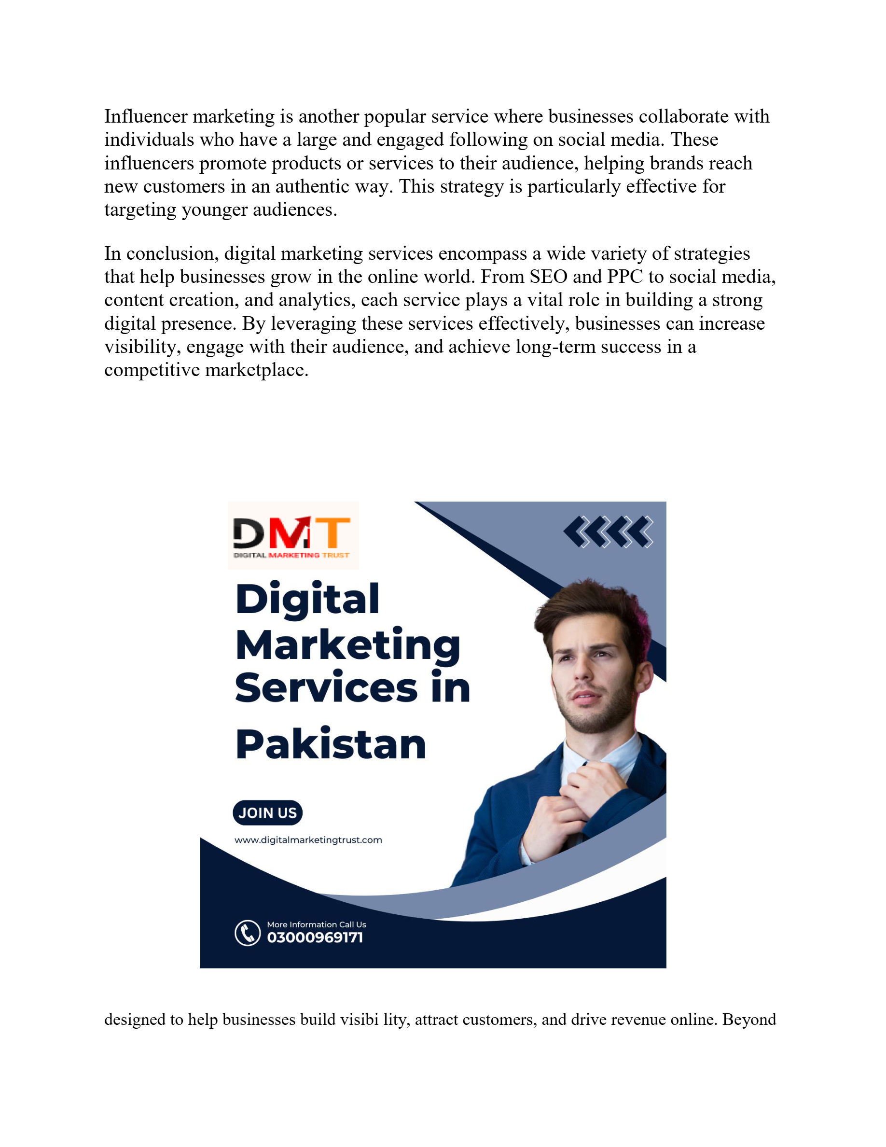
Slide 3
Notes:
Influencer marketing is another popular service where businesses collaborate with individuals who have a large and engaged following on social media. These influencers promote products or services to their audience, helping brands reach new customers in an authentic way. This strategy is particularly effective for targeting younger audiences. In conclusion, digital marketing services encompass a wide variety of strategies that help businesses grow in the online world. From SEO and PPC to social media, content creation, and analytics, each service plays a vital role in building a strong digital presence. By leveraging these services effectively, businesses can increase visibility, engage with their audience, and achieve long-term success in a competitive marketplace. designed to help businesses build visibi lity, attract customers, and drive revenue online. Beyond

Slide 4
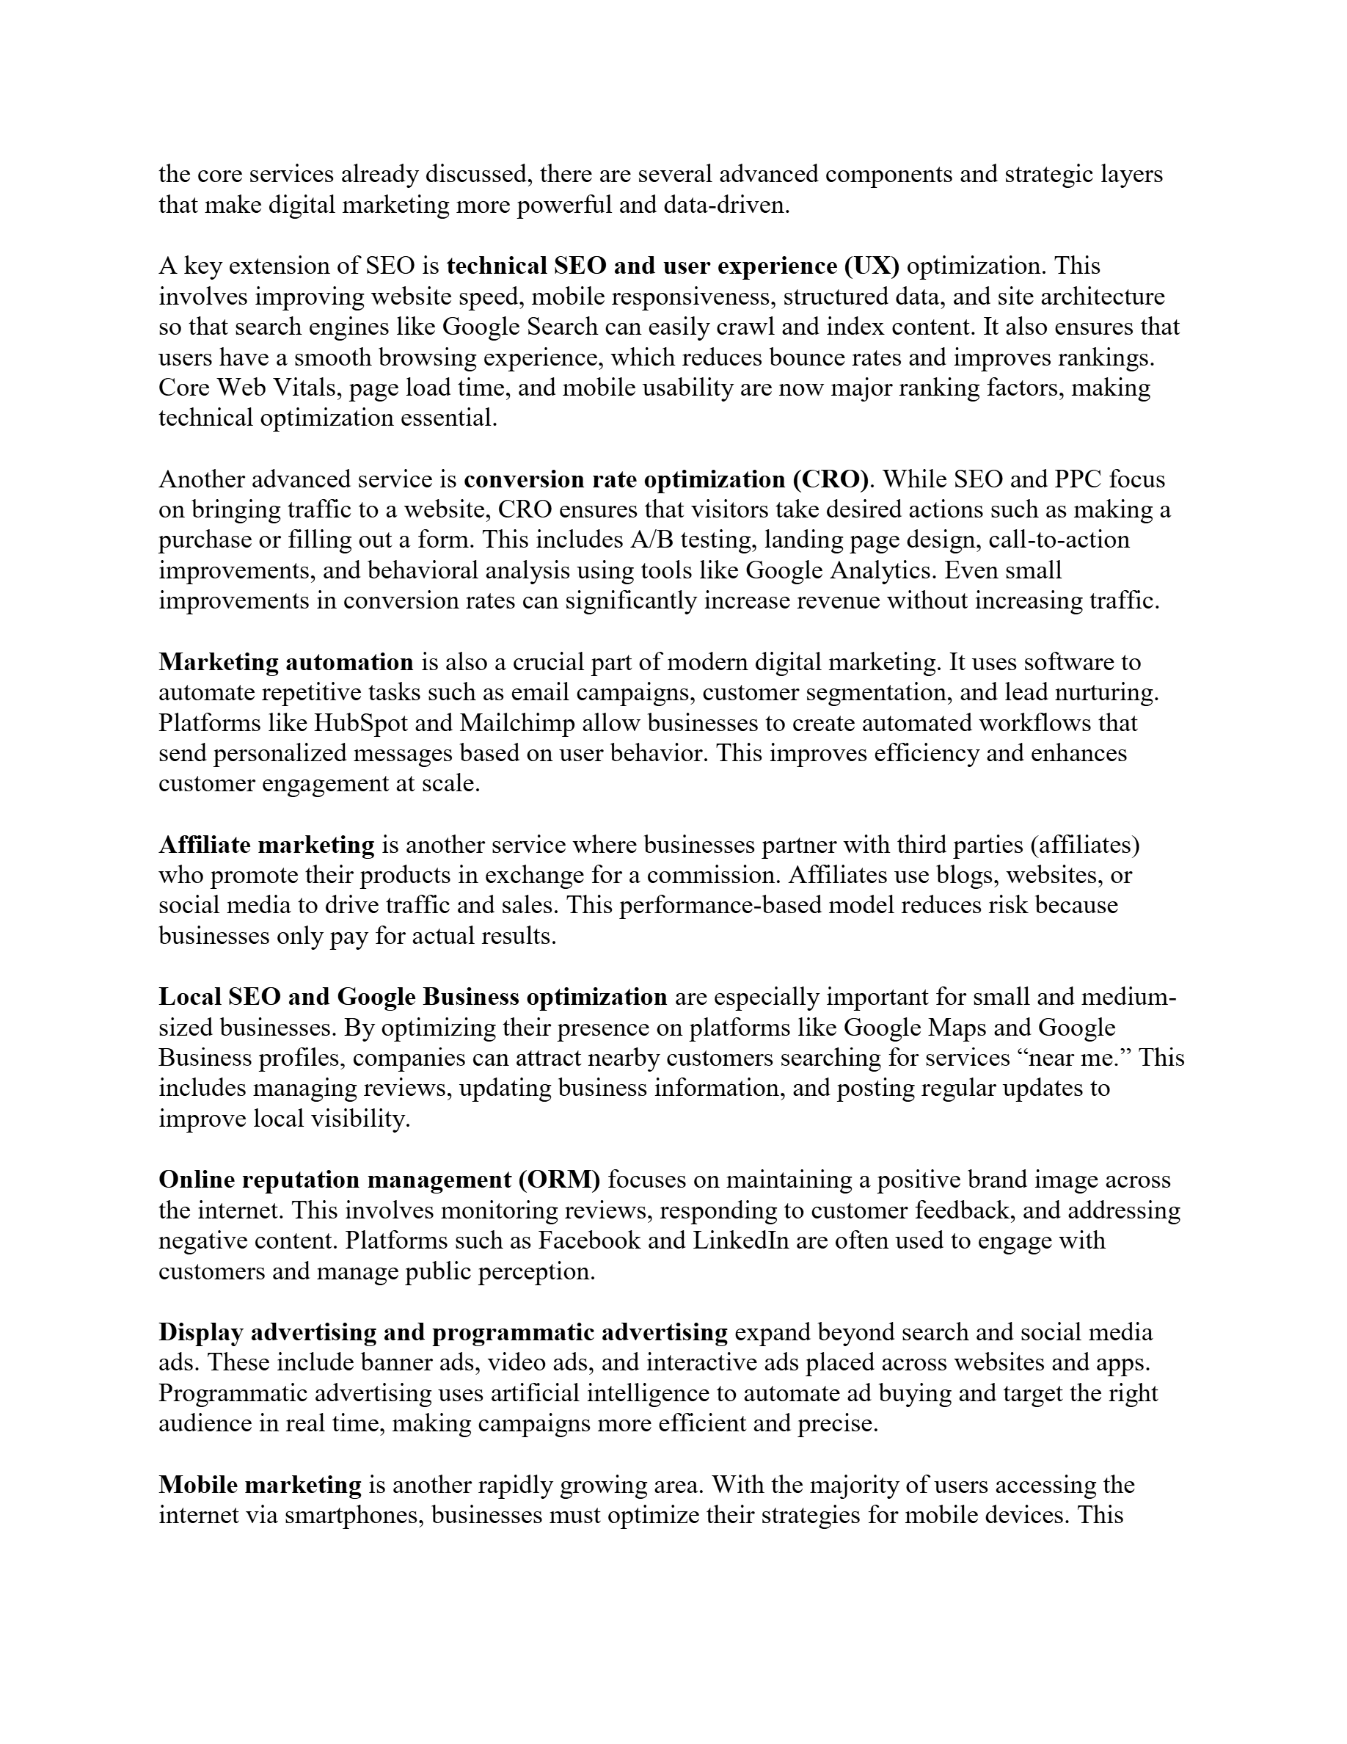
Slide 4
Notes:
the core services already discussed, there are several advanced components and strategic layers that make digital marketing more powerful and data-driven. A key extension of SEO is technical SEO and user experience (UX) optimization. This involves improving website speed, mobile responsiveness, structured data, and site architecture so that search engines like Google Search can easily crawl and index content. It also ensures that users have a smooth browsing experience, which reduces bounce rates and improves rankings. Core Web Vitals, page load time, and mobile usability are now major ranking factors, making technical optimization essential. Another advanced service is conversion rate optimization (CRO) . While SEO and PPC focus on bringing traffic to a website, CRO ensures that visitors take desired actions such as making a purchase or filling out a form. This includes A/B testing, landing page design, call-to-action improvements, and behavioral analysis using tools like Google Analytics. Even small improvements in conversion rates can significantly increase revenue without increasing traffic. Marketing automation is also a crucial part of modern digital marketing. It uses software to automate repetitive tasks such as email campaigns, customer segmentation, and lead nurturing. Platforms like HubSpot and Mailchimp allow businesses to create automated workflows that send personalized messages based on user behavior. This improves efficiency and enhances customer engagement at scale. Affiliate marketing is another service where businesses partner with third parties (affiliates) who promote their products in exchange for a commission. Affiliates use blogs, websites, or social media to drive traffic and sales. This performance-based model reduces risk because businesses only pay for actual results. Local SEO and Google Business optimization are especially important for small and medium- sized businesses. By optimizing their presence on platforms like Google Maps and Google Business profiles, companies can attract nearby customers searching for services “near me.” This includes managing reviews, updating business information, and posting regular updates to improve local visibility. Online reputation management (ORM) focuses on maintaining a positive brand image across the internet. This involves monitoring reviews, responding to customer feedback, and addressing negative content. Platforms such as Facebook and LinkedIn are often used to engage with customers and manage public perception. Display advertising and programmatic advertising expand beyond search and social media ads. These include banner ads, video ads, and interactive ads placed across websites and apps. Programmatic advertising uses artificial intelligence to automate ad buying and target the right audience in real time, making campaigns more efficient and precise. Mobile marketing is another rapidly growing area. With the majority of users accessing the internet via smartphones, businesses must optimize their strategies for mobile devices. This

Slide 5
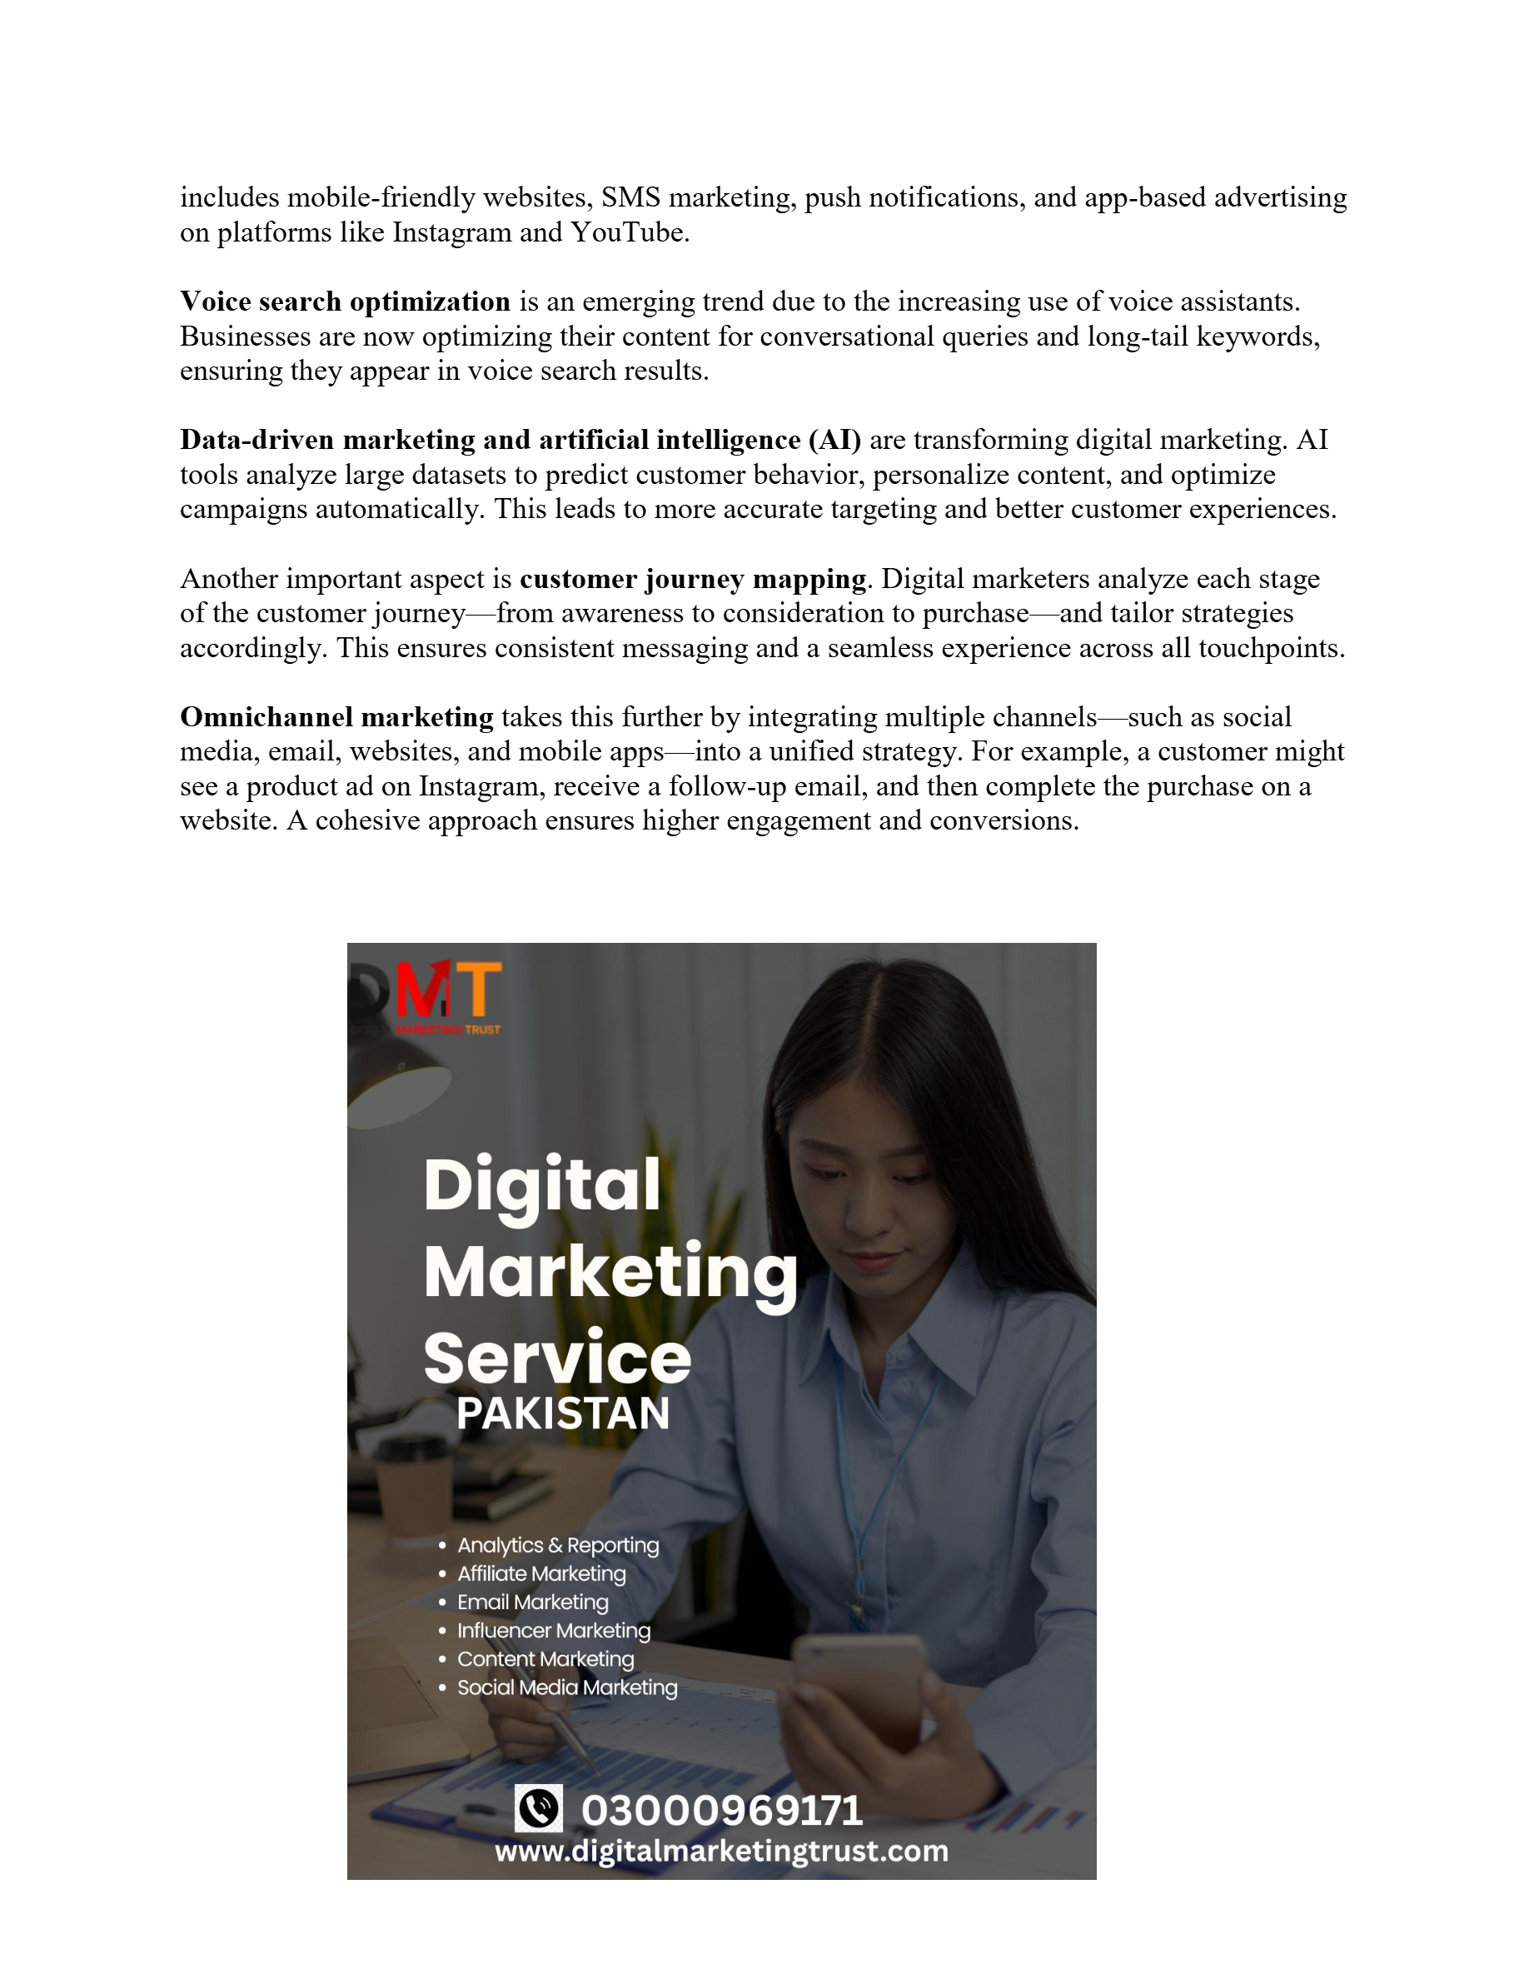
Slide 5
Notes:
includes mobile-friendly websites, SMS marketing, push notifications, and app-based advertising on platforms like Instagram and YouTube. Voice search optimization is an emerging trend due to the increasing use of voice assistants. Businesses are now optimizing their content for conversational queries and long-tail keywords, ensuring they appear in voice search results. Data-driven marketing and artificial intelligence (AI) are transforming digital marketing. AI tools analyze large datasets to predict customer behavior, personalize content, and optimize campaigns automatically. This leads to more accurate targeting and better customer experiences. Another important aspect is customer journey mapping . Digital marketers analyze each stage of the customer journey — from awareness to consideration to purchase — and tailor strategies accordingly. This ensures consistent messaging and a seamless experience across all touchpoints. Omnichannel marketing takes this further by integrating multiple channels — such as social media, email, websites, and mobile apps — into a unified strategy. For example, a customer might see a product ad on Instagram, receive a follow-up email, and then complete the purchase on a website. A cohesive approach ensures higher engagement and conversions.

